Slide 1
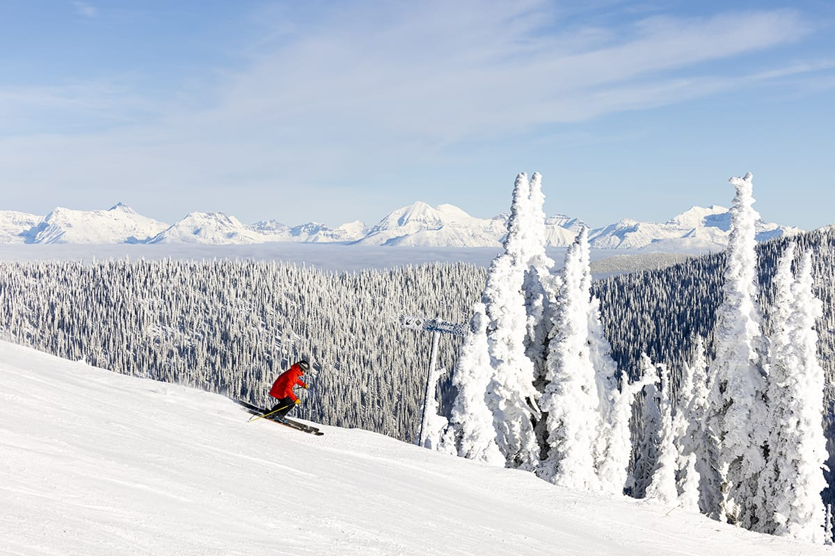
Big Mountain Ski Resort: Ticket Price Model

Slide 2
Agenda
Problem Identification
Key Findings & Recommendation
Modeling Results and Analysis
Summary & Conclusion

Slide 3

Problem Identification
Ticket cost based on average market price
Does not account for difference in facilities
Which facilities can Big Mountain Resort remove to cut costs and add to maintain or increase ticket price through customer valuation of its facilities by the end of next season?

Slide 4
Key Findings
Big Mountain Resort is a leader in valuable features – this fact currently has no impact on price.
Currently charges $81 per adult ticket, but model suggests a price of $95.87. Accounting for the mean absolute error of $10.39, this still suggests up to $4.50 increase.
Recommendation
Add an additional run, increasing the drop by 150 ft, and installing a new chair lift – analysis shows this will justify an increase in ticket price by $1.99
Close 1 run to save on operating costs – analysis shows this will not affect ticket price

Slide 5
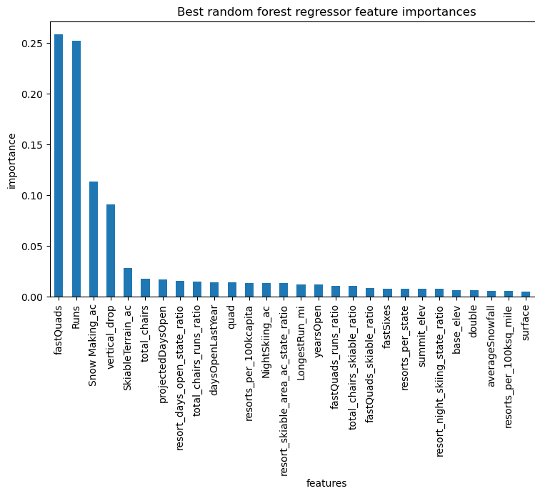
Random Forest model
Important features for predicting price:
fastQuads
Runs
Snow Making_ac
vertical_drop
SkiableTerrain_ac

Slide 6
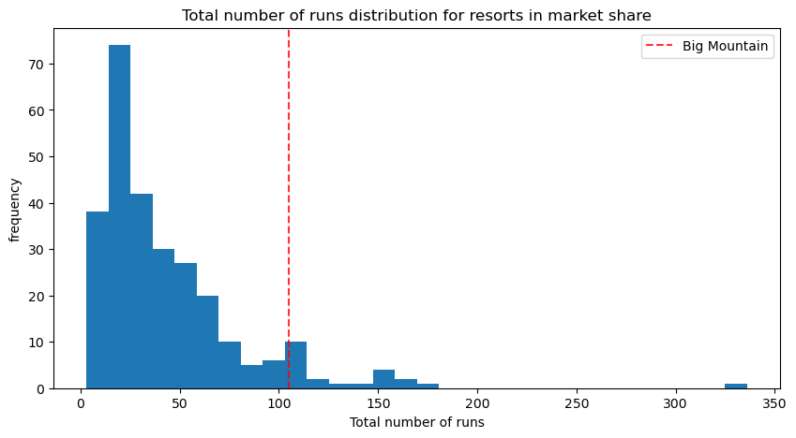
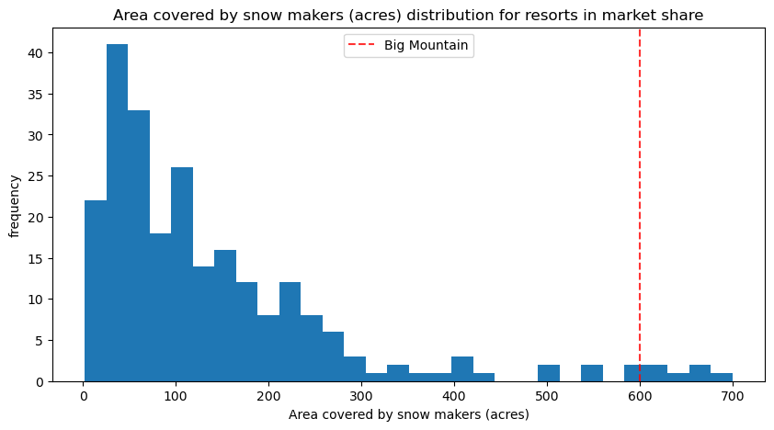
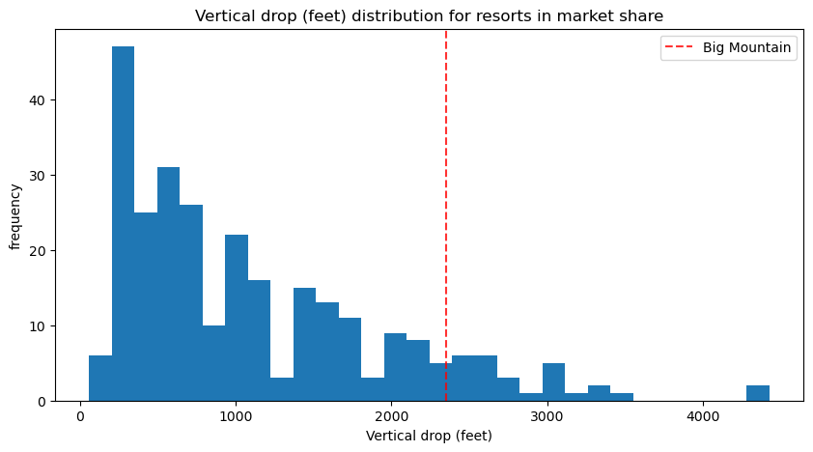
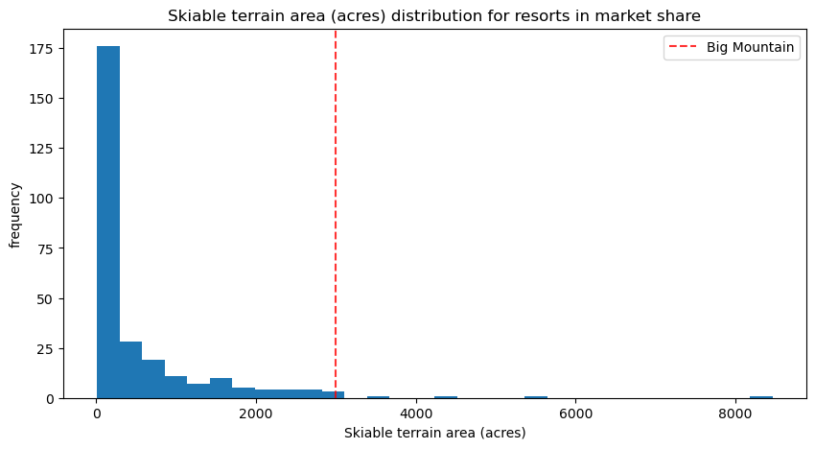
Important Feature Distributions

Slide 7

Scenario Considerations
Scenario 1 (closing runs) requires knowledge of operation costs, but could be feasible if savings exceed the necessary decrease in ticket price.
Scenario 2, i.e., adding a run, increasing the drop by 150 ft, and installing an additional chair lift, works well with the fitted model and suggests an increase in ticket price by $1.99.
Scenario 3 is identical to Scenario 2 with the addition of 2 acres of snow making – the results, however, suggested no change in ticket price.
Scenario 4 did not justify increasing ticket price.

Slide 8

Summary & Conclusion
Problem Identification: Current ticket pricing does not account for differences in facilities.
Model Insights: Important features for predicting price include fastQuads, runs, and vertical drop.
Key Findings: Big Mountain Resort can increase ticket price by up to $4.50 based on model analysis.
Scenarios: Scenario 2 (adding a run and chair lift) is most effective for increasing ticket price.
Recommendations: Adding a run and new chair lift can justify a $1.99 increase in ticket price. Closing the least-used run will decrease operation costs without affecting ticket price; additional closures necessarily decrease ticket price, so operation cost data is required for proper recommendations.

